Slide 1
22
Running Safety
Alan Pisano
Running Safety Plus
Team 22
Thomas Cimino tpcimino@bu.edu
Zexing Gao zexing@bu.edu
Cong Han hancong@bu.edu
Payton Hauck phauck@bu.edu
Yajing Lai cassielo@bu.edu

Slide 2
22
Running Safety
Alan Pisano
Problem Statement
Recently there has been a rise in the attempts of abductions and sexual assault attacks on local joggers, specifically women.
Our solution is to design a fully-functional, concealable, and durable device that a runner will wear and will detect these possible emergencies.
Our device does not rely on a mobile device or any deliberate action from the user in order for our system to be alarmed.

Slide 3
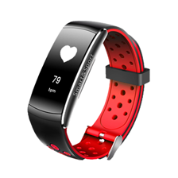
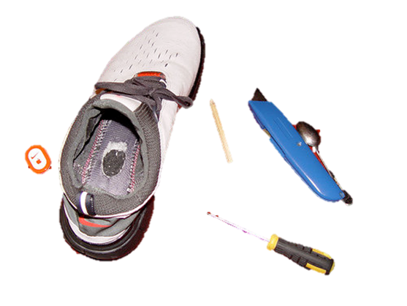
22
Running Safety
Alan Pisano
Visualization - Wearable Components

Slide 4
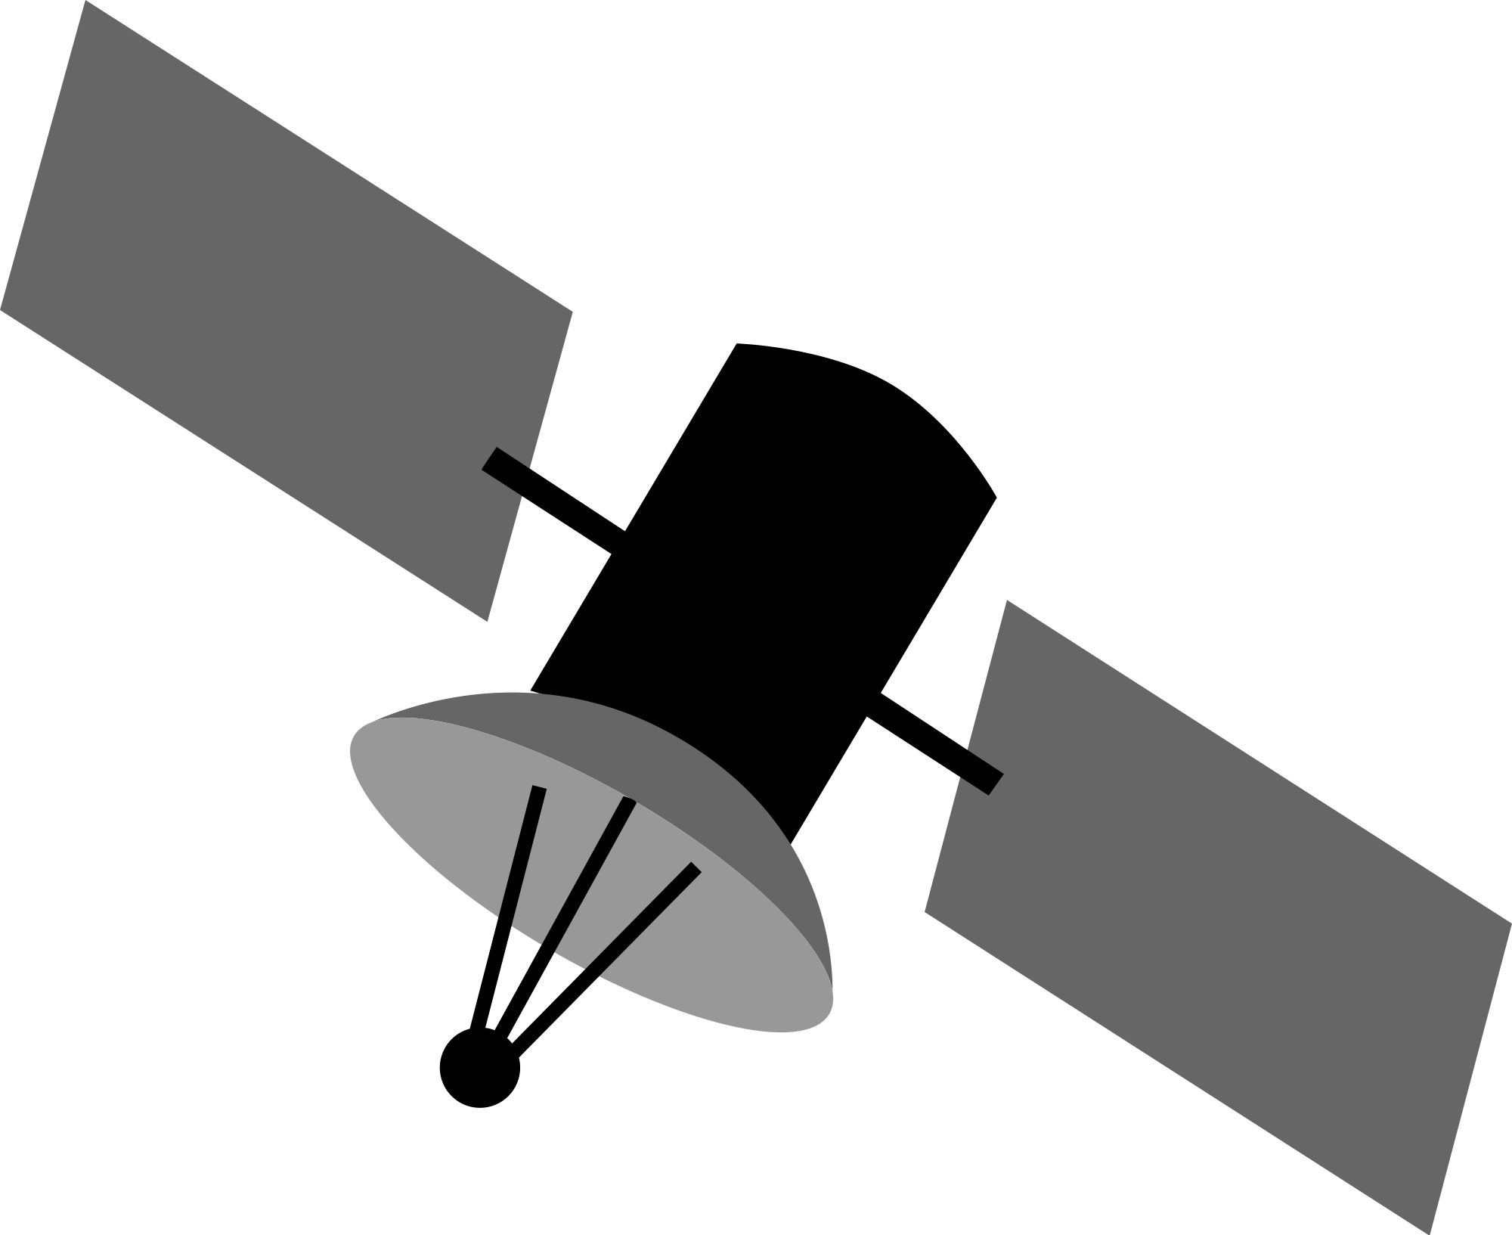
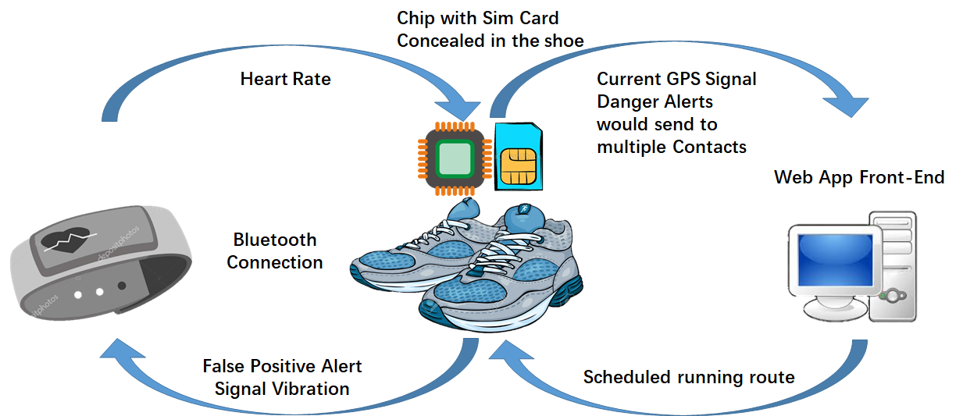
22
Running Safety
Alan Pisano
GPS

Slide 5
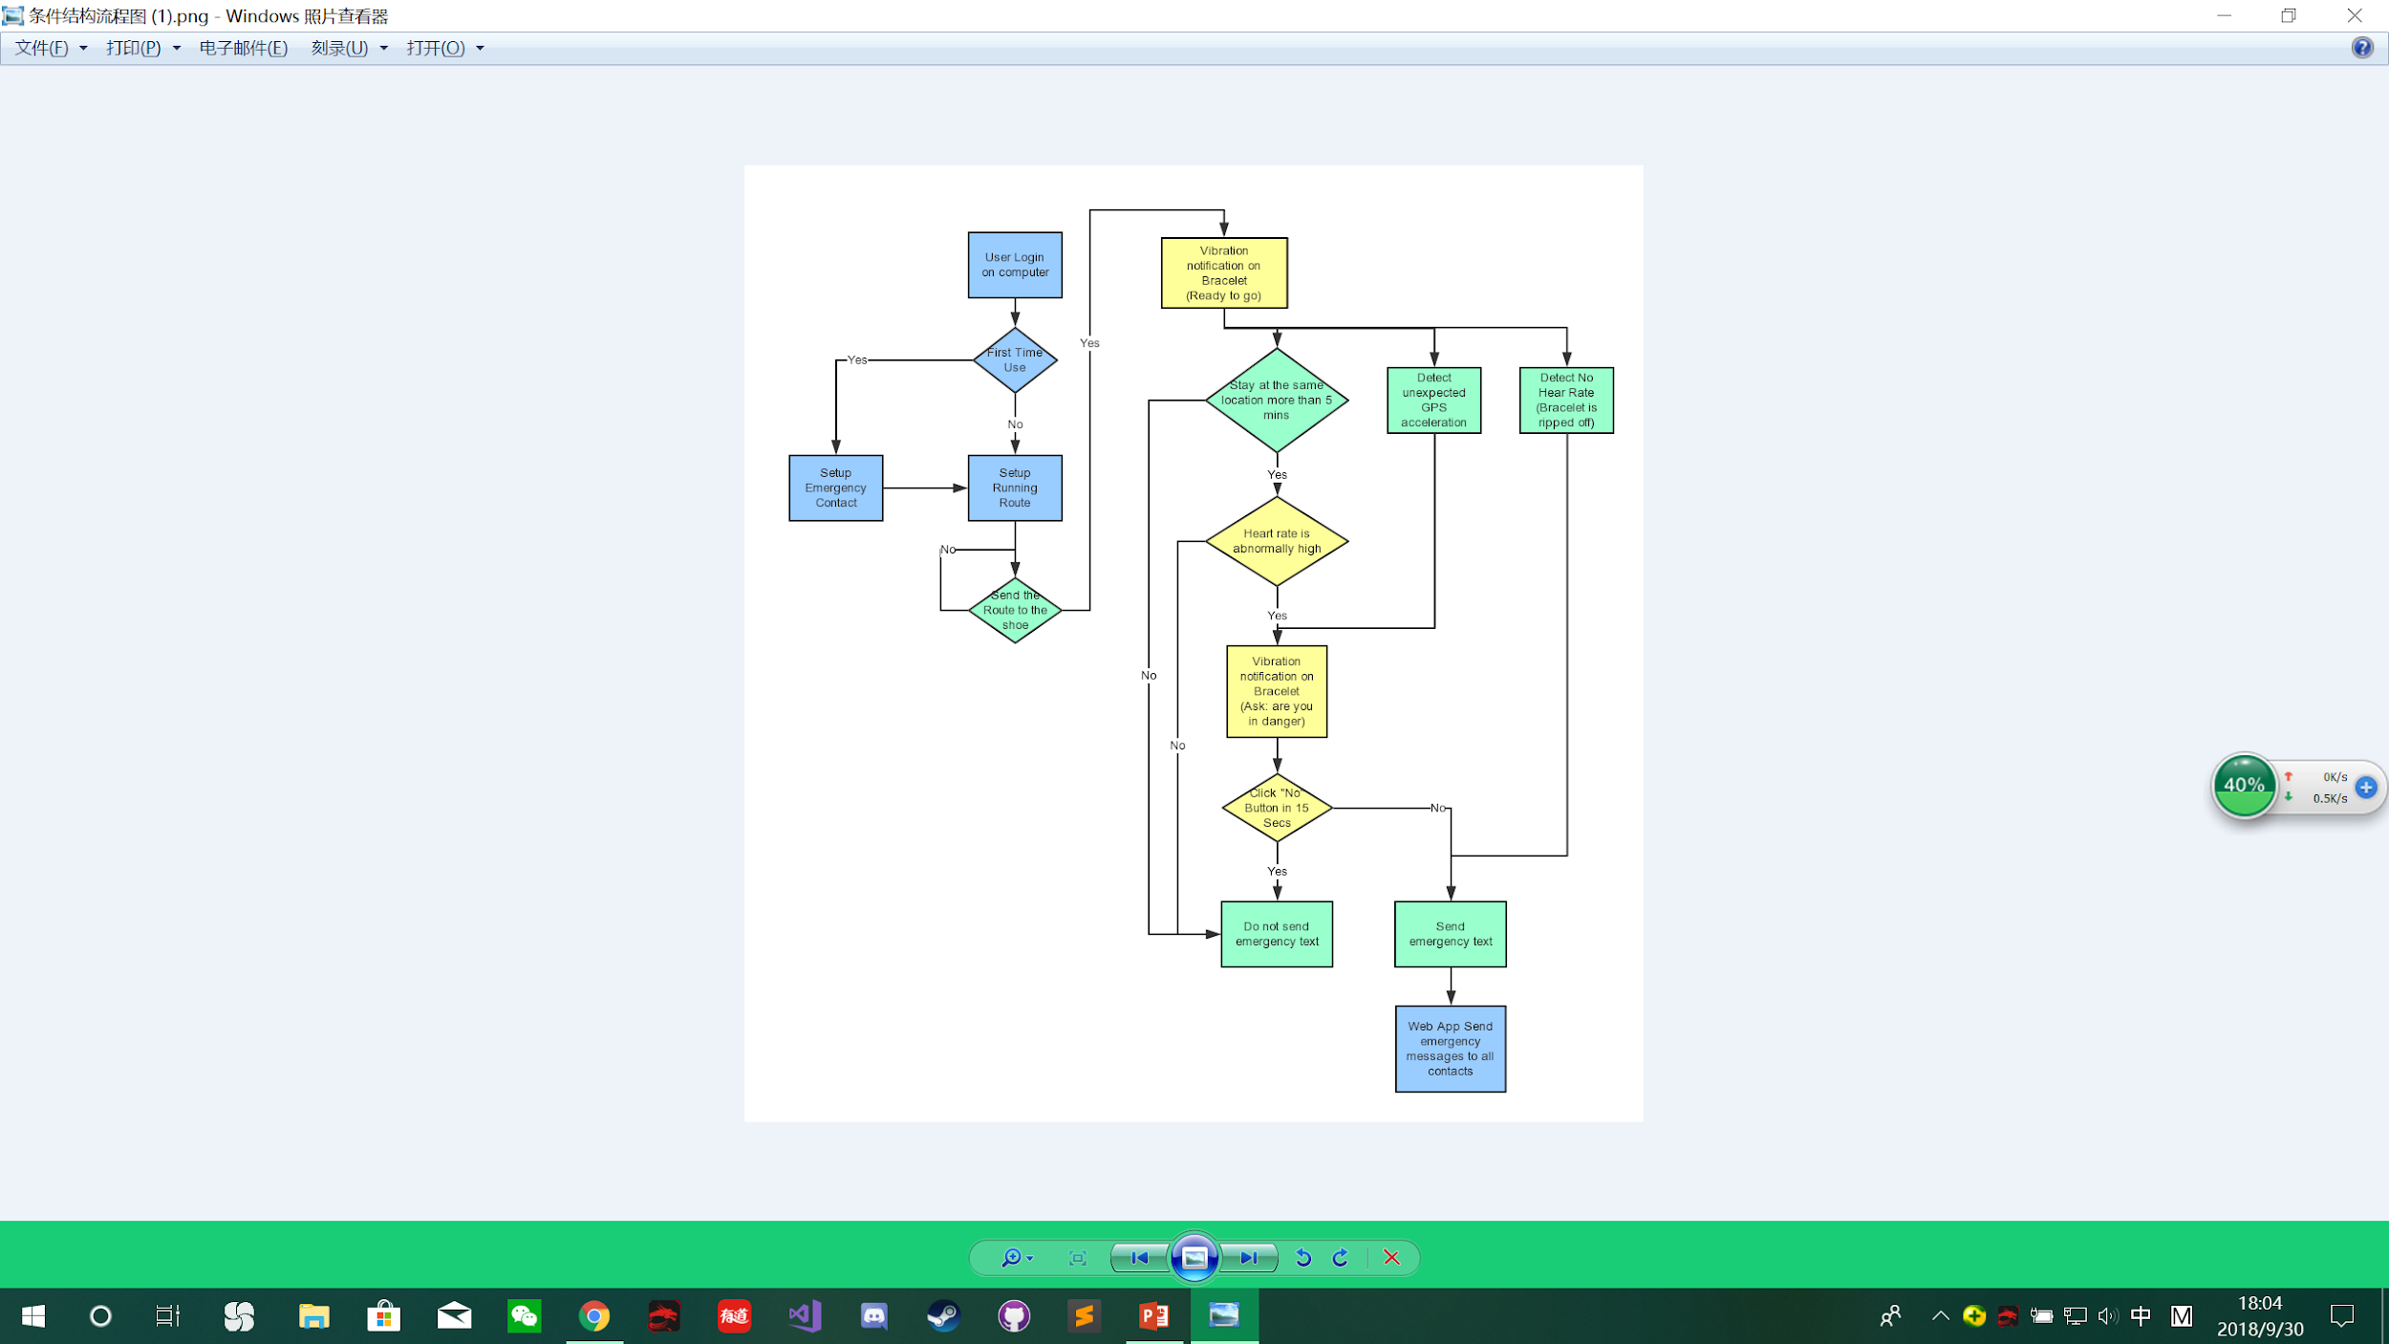
22
Running Safety
Alan Pisano
Green: In-shoe Device
Yellow: Bracelet
Blue: Web App Front-End

Slide 6
22
Running Safety
Alan Pisano
SW Deliverables
Heat rate detection
Running route trace
Interface for programmed emergency contact

Slide 7
22
Running Safety
Alan Pisano
HW Deliverables
Shoe
GPS Receiver
SMS Transmitter
Connection to bracelet/chest strap
Bracelet/chest strap
Pulse monitor
Accelerometer
False positive cancellation button

Slide 8
22
Running Safety
Alan Pisano
Requirements
Primary Function:
To detect a runner in distress due to dangerous/unexpected emergency. Measures specific objectives to detect this and report the emergency.
Objectives:
GPS Tracking - follow user’s location and track
Heart Rate Monitor - measure for significant drops/spikes maybe due to health emergency or adrenaline rush
Accelerometer - follow pace of runner (maximum = ~20 mph)
Outreach System - user programs emergency contact to be reached in case alarm triggered

Slide 9
Requirements
Running Safety
Constraints:
Not Easily Detectable
Shoe insert is hidden and non-visible
Very Small/Light in Weight
< 100g for each individual part (wrist/chest band & shoe insert)
Sturdy/Strong
Able to survive running pressure (shoe insert)
Cost
Cheap as possible, competing technology ~$100
Long Lasting Battery
Survive entire run length (Goal = 6 hours)
Easy to Use
Available to all ages

Slide 10
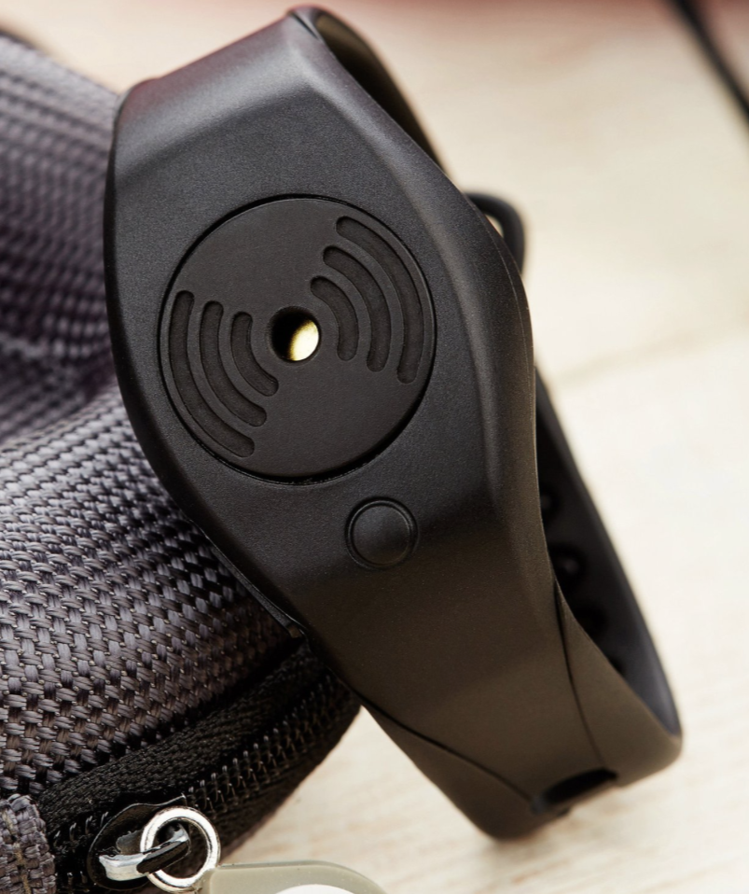
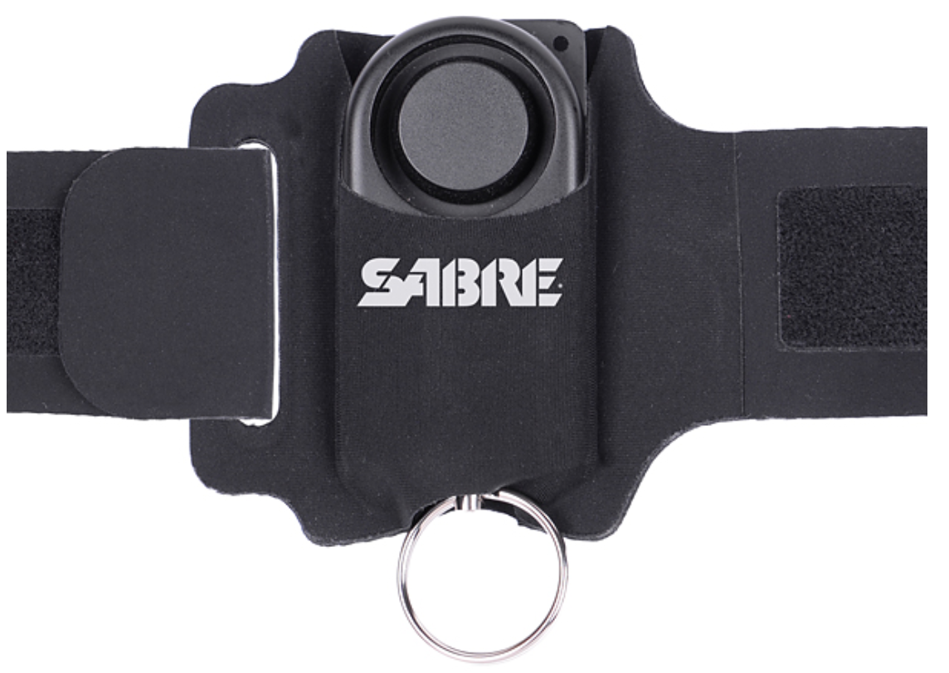
22
Running Safety
Alan Pisano
Competing Products
RunAngel
(a). App send GPS location and alert message to emergency contacts via
SMS & email.
(b). Emits a very loud alarm to attract attention in an emergency.
(c). Contains a rechargeable battery which is charged via a micro USB lead.
SABRE
(a). Have Piercing, alarm calls for attention up to helps scare off attacker.
(b). Pull the metal ring to operate.
Our Advantages: Undetectable / intelligent / Hard to be taken down.

Slide 11
Our Product
Automatically detect the danger and take action immediately.
Keep send both message and gps location to emergency contact when activate.
Can hide inside runner’s shoes.
Provide runners more secure experience.

